Slide 1
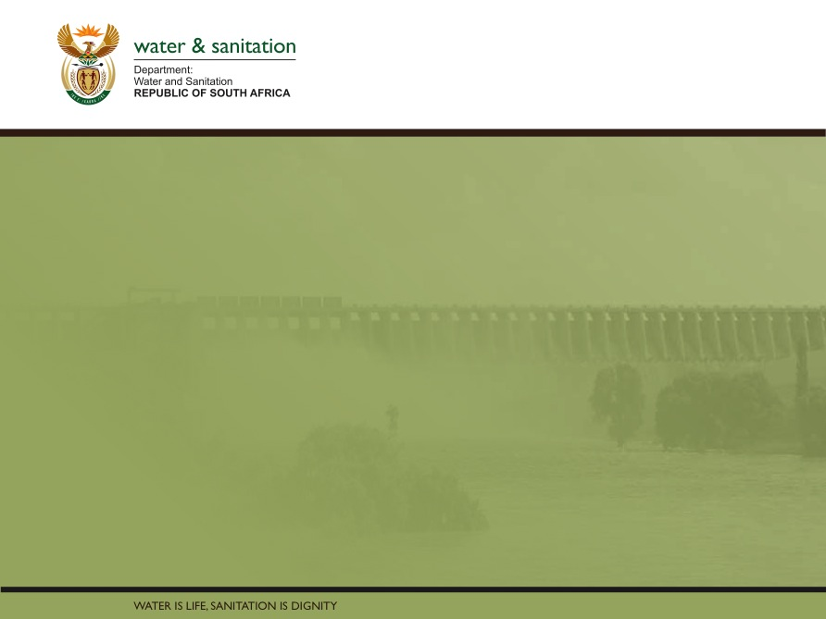
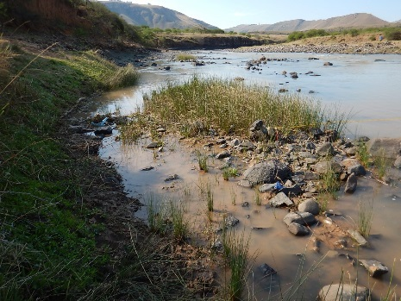
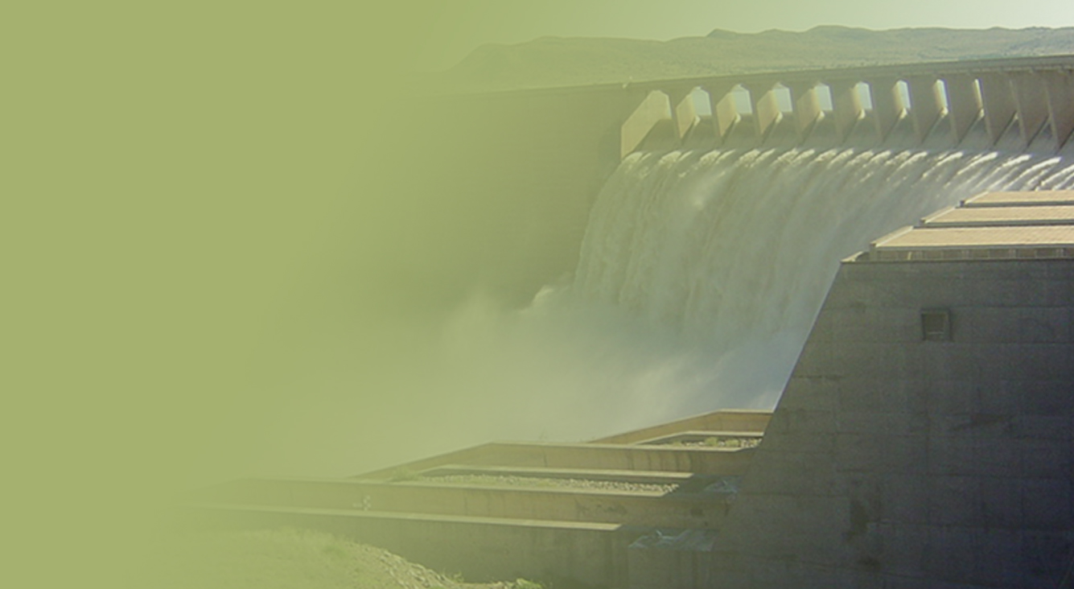
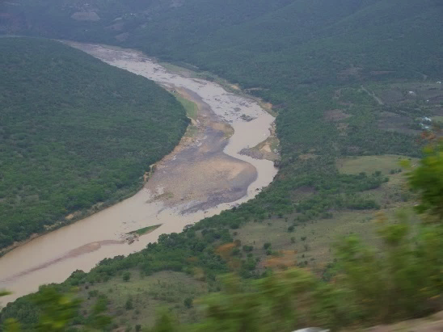
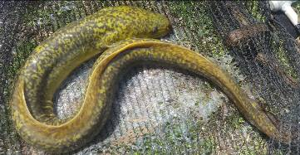
WP 11004: PSC MEETING 3,
13 FEBRUARY 2018
PRESENTATION TITLE
Presented by:
Name Surname
Directorate
Date
DETERMINATION OF WATER RESOURCE CLASSES AND RESOURCE QUALITY OBJECTIVES FOR THE WATER RESOURCES IN THE MZIMVUBU CATCHMENT:
CLASSES AND CATCHMENT CONFIGURATION
Patsy Scherman and Delana Louw

Slide 2
PROJECT PLAN

Slide 3
PROCESS
Step-wise approach followed to identify Classes and catchment configurations.
Scenario modelling step: The significant developmental scenario assessed was the building of Ntabelanga and Lalini dams (although not yet approved).
The following four variables were assessed during the Scenario Consequences step:
  Ecological (river and estuary)
  Ecosystem Services
  GDP
  Employment in terms of number of jobs
Consequences were evaluated and Classes defined using the Water Resource Class Determination Tool.
Results and Classes presented to DWS.
Team recommendation: THIS PRESENTATION

Slide 4
REMINDERS
RU = unit of delineation for the Reserve: Nested with IUAs and may contain an EWR site.
IUA = unit of delineation for Classification: An area to be managed as an entity in terms of water resource operations, quality, socio-economics and ecosystem services.
PES: Current integrated state of a water resource.
REC: Future ecological state (Ecological Categories A to D) that can be recommended for a resource.
TEC: The is the resulting Ecological Category based on the Class. One will always strive to meet the REC, however once the balance between use and protection is considered, the TEC may be the PES, the REC or any other category.
Note:
  The Water Resource CLASS of an IUA is defined by the distribution of the selected Ecological Categories (the catchment configuration) for the biophysical nodes in the IUA.

Slide 5
RESULTS (1)
The Tsitsa River (T35), downstream Mzimvubu and estuary (T36) are the only Resource Units potentially affected by the dam-building/HEPP scenarios.
The Scenario results table shows Scenario 69 as the preferred scenario, which maintains Classes as under the PES or improves the current state (IUA T32_b).
Management option with NO flows over Tsitsa Falls not acceptable.

Slide 6
RESULTS (2)
Sc 69 preferred as includes 2017 Design Phase operations and flow out of Lalini Dam. How much released depends on hydropower requirements.
Sc 69 meets PES or REC requirements for all biophysical nodes.
The outcome of the decision analysis should be analysed and incorporated into the MWP infrastructure final design by the design team.
The MWP catchment should be carefully monitored and controlled and upstream development should be limited as this will impact negatively on the economics of the scheme.

Slide 7
THIS PRESENTATION
  Using maps and the following colour coding, provide the Water Resource Class for T3 and a selection of IUAs with nodes requiring intervention.
  For selected IUAs provide a summary of the interventions required to achieve the Class and Ecological Categories for the catchment configuration.
  These interventions provide the implications of the WRC and catchment configuration.
WRC I
WRC II
WRC III

Slide 8
RESULTS (3)
IUAs with no impacts on users/economy or ecology under Sc 69, and no interventions needed, are as follows:
IUA T33_a: WRC II
IUA T34_b: WRC II
IUA T35_a: WRC I
IUA T35_d: WRC II
IUA T36_a: WRC I
IUA T36_b: WRC I

Slide 9
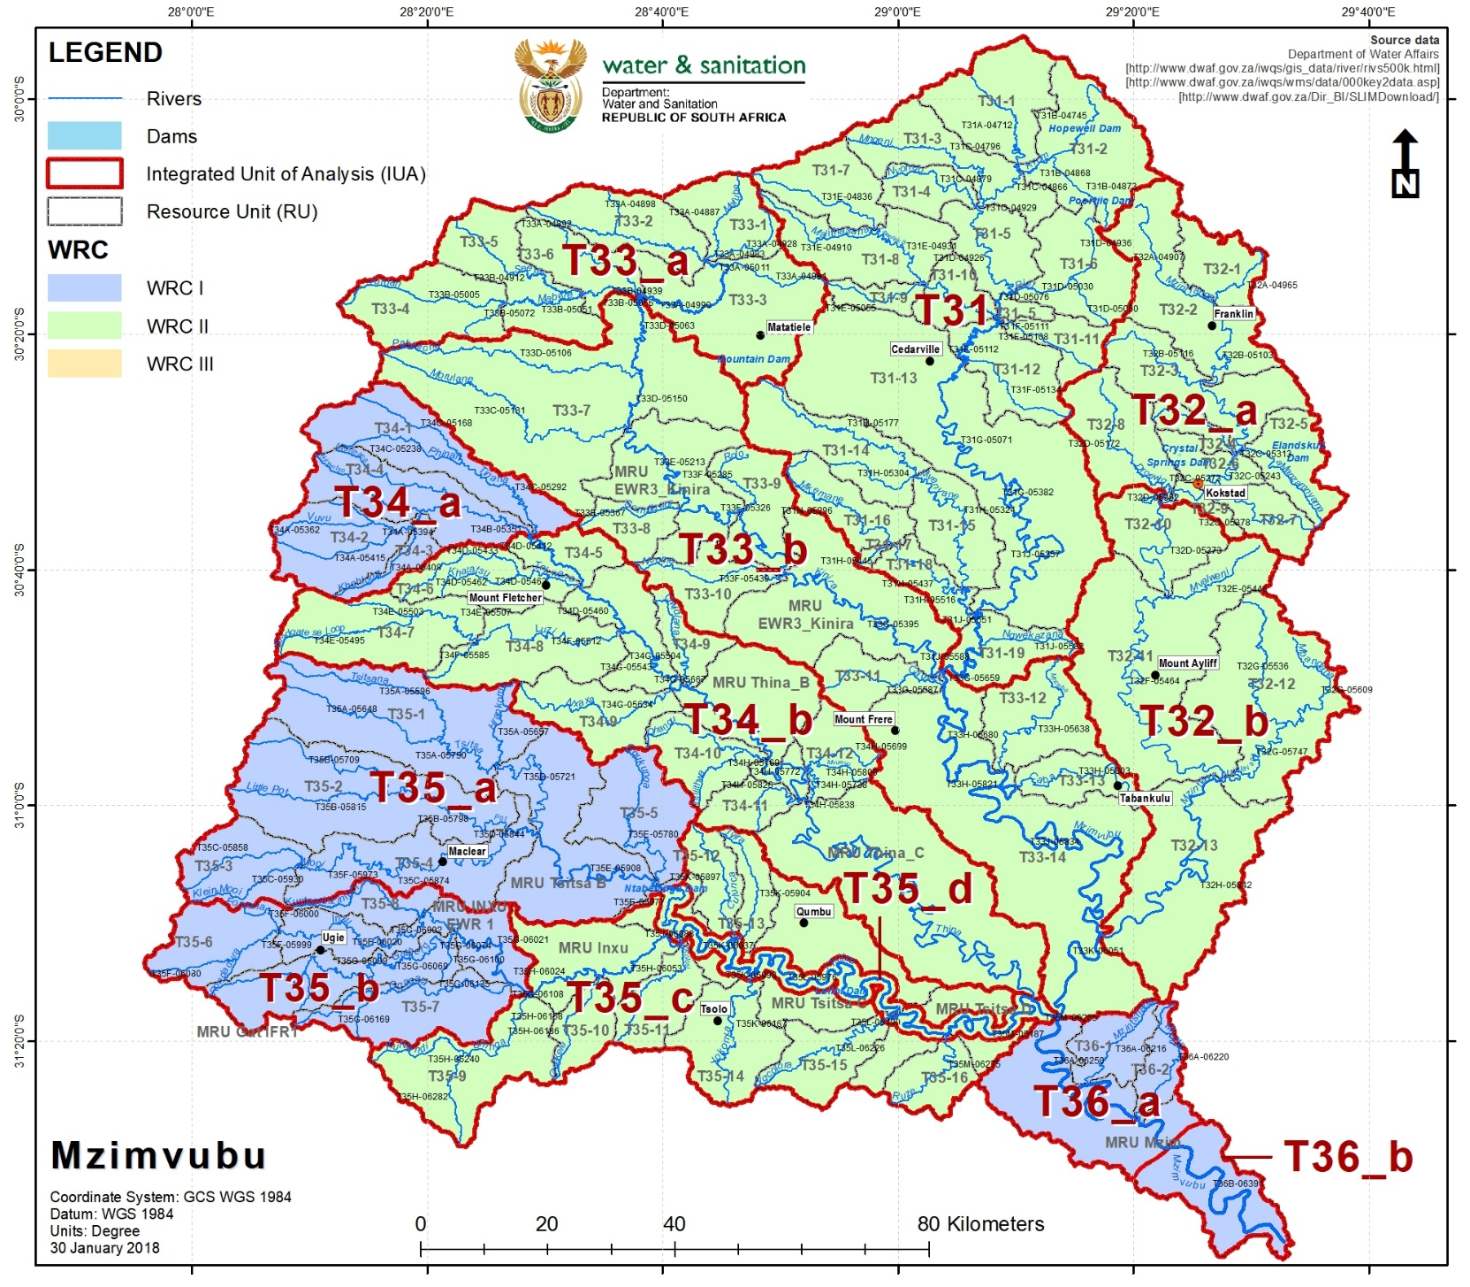
DRAFT WATER RESOURCE CLASSES FOR T3

Slide 10
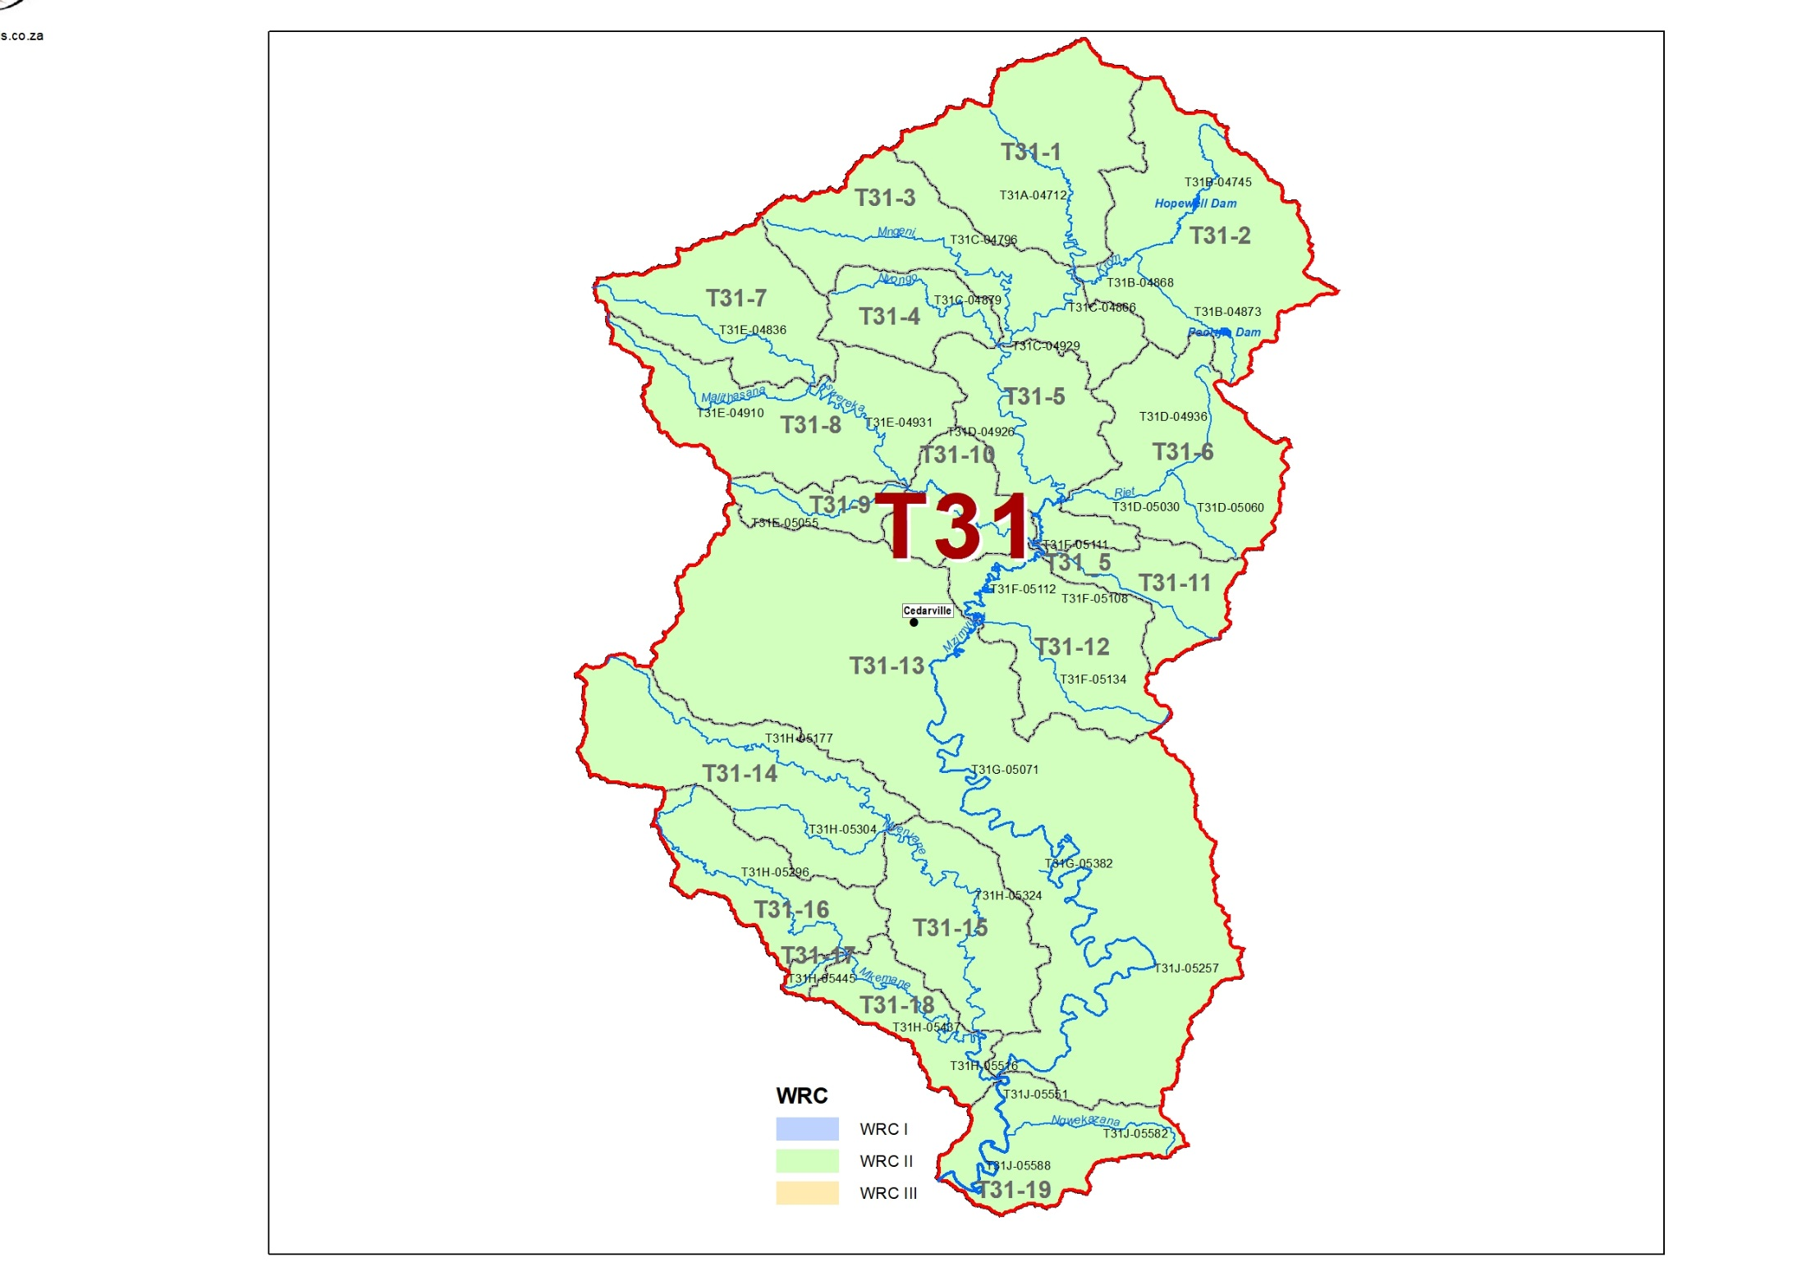
DRAFT WRC: IUA T31
T31-17: C → B/C
Possible sewage treatment required. Erosion control and improved agricultural practices. Alien vegetation removal.
T31-18, Mkemane River: C/D → B/C.
Water quality improvement required in terms of sedimentation, i.e. erosion control.

Slide 11
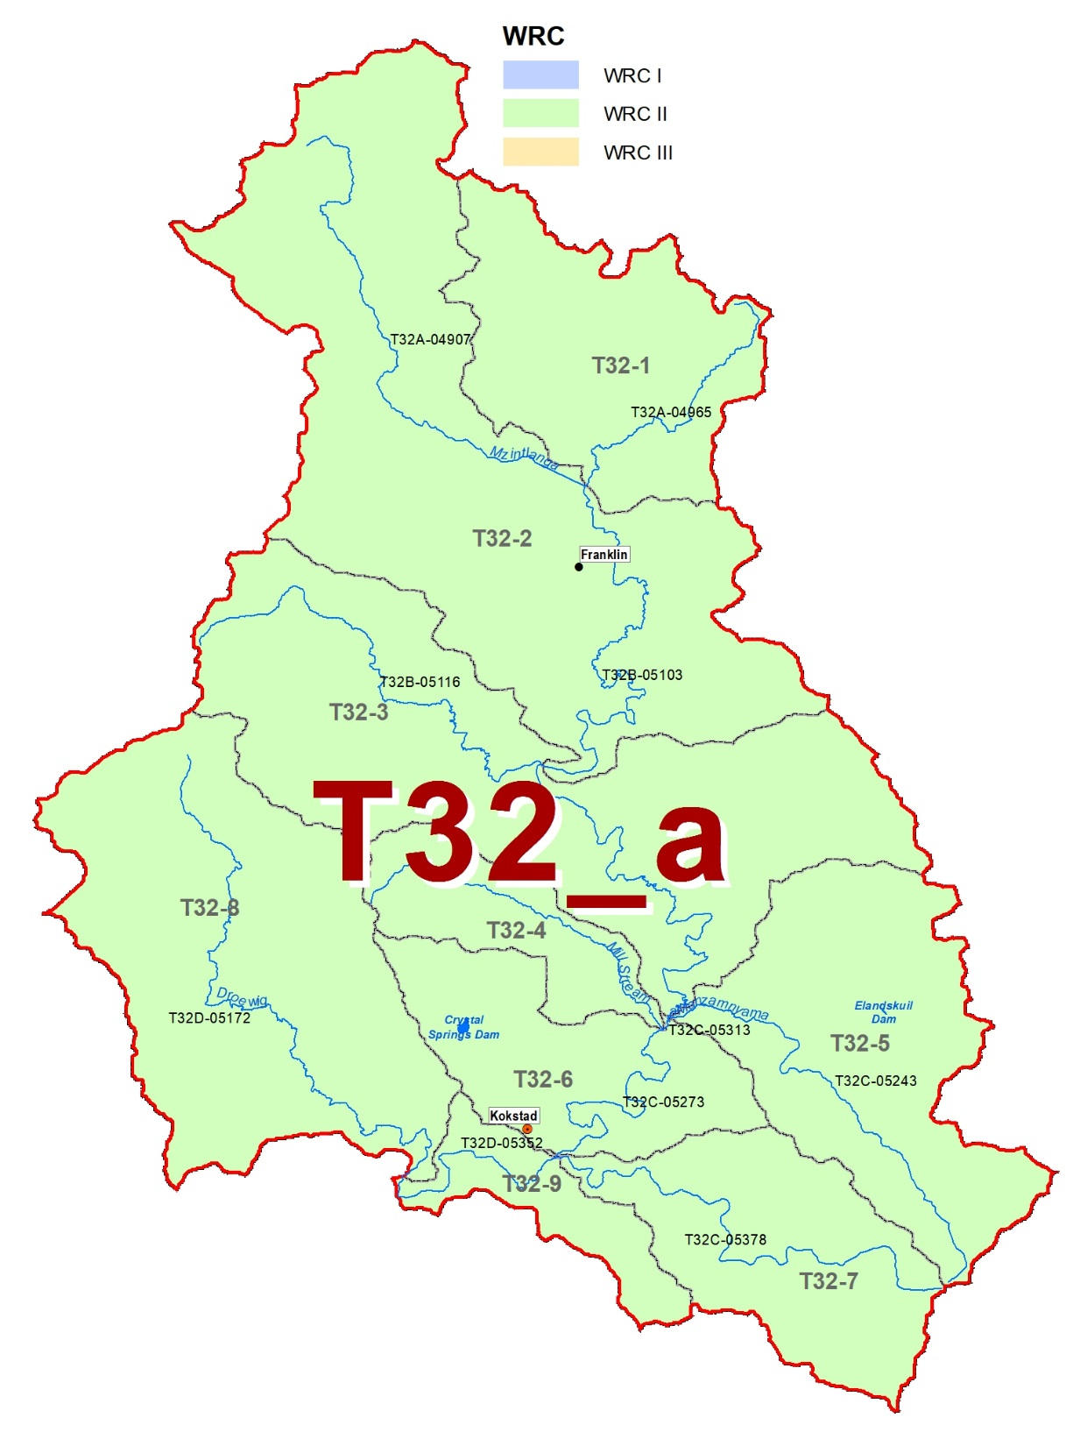
DRAFT WRC: IUA T32_a
T32-1, Mzintlava River: C → B/C
Flow only needs to improve as it relates to sensitivity. Control and management of dams.
T32-3: C → B/C
Flow only needs to improve as it relates to sensitivity. Control of, amongst others, pivot irrigation, to supply EWR.
T32-4, Mill Stream: C → B/C
Combination of flow and non-flow impacts.

Slide 12
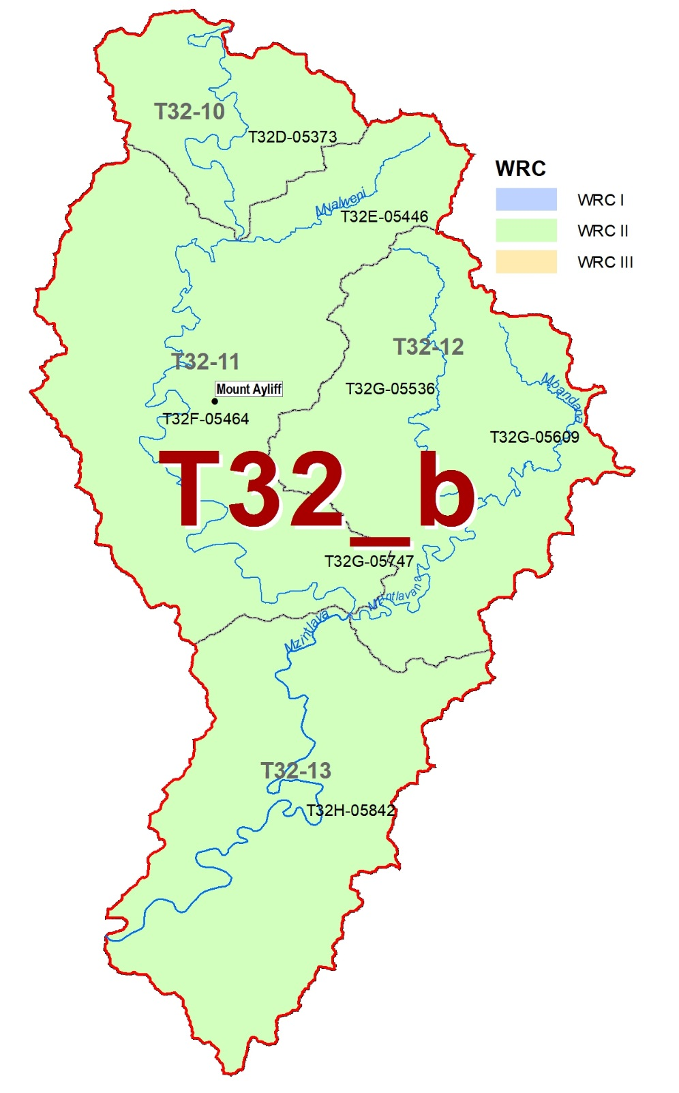
DRAFT WRC: IUA T32_b
WRC II
Sc 69 results in an overall improvement from WRC III (PES) to WRC II (REC)
T32-11, Mzintlava River: C/D → C.
Erosion control and improved agricultural practices. Alien vegetation removal.
T32-12, Mzintlavana River: B/C → B.
Erosion control. Alien vegetation removal.
T32-13, Mzintlava River: C → B
Improve riparian continuity by improving riparian buffer zone (floodplain agriculture).

Slide 13
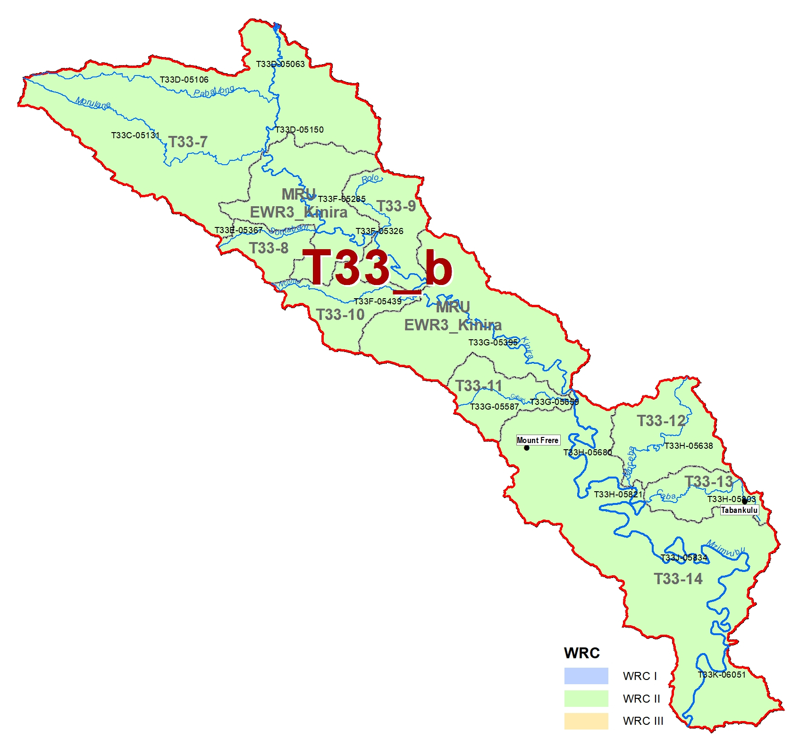
DRAFT WRC: IUA T33_b
T33-13, Caba River: C → B.
Improvement of WWTW discharge quality, erosion prevention, and riparian buffer protection.

Slide 14
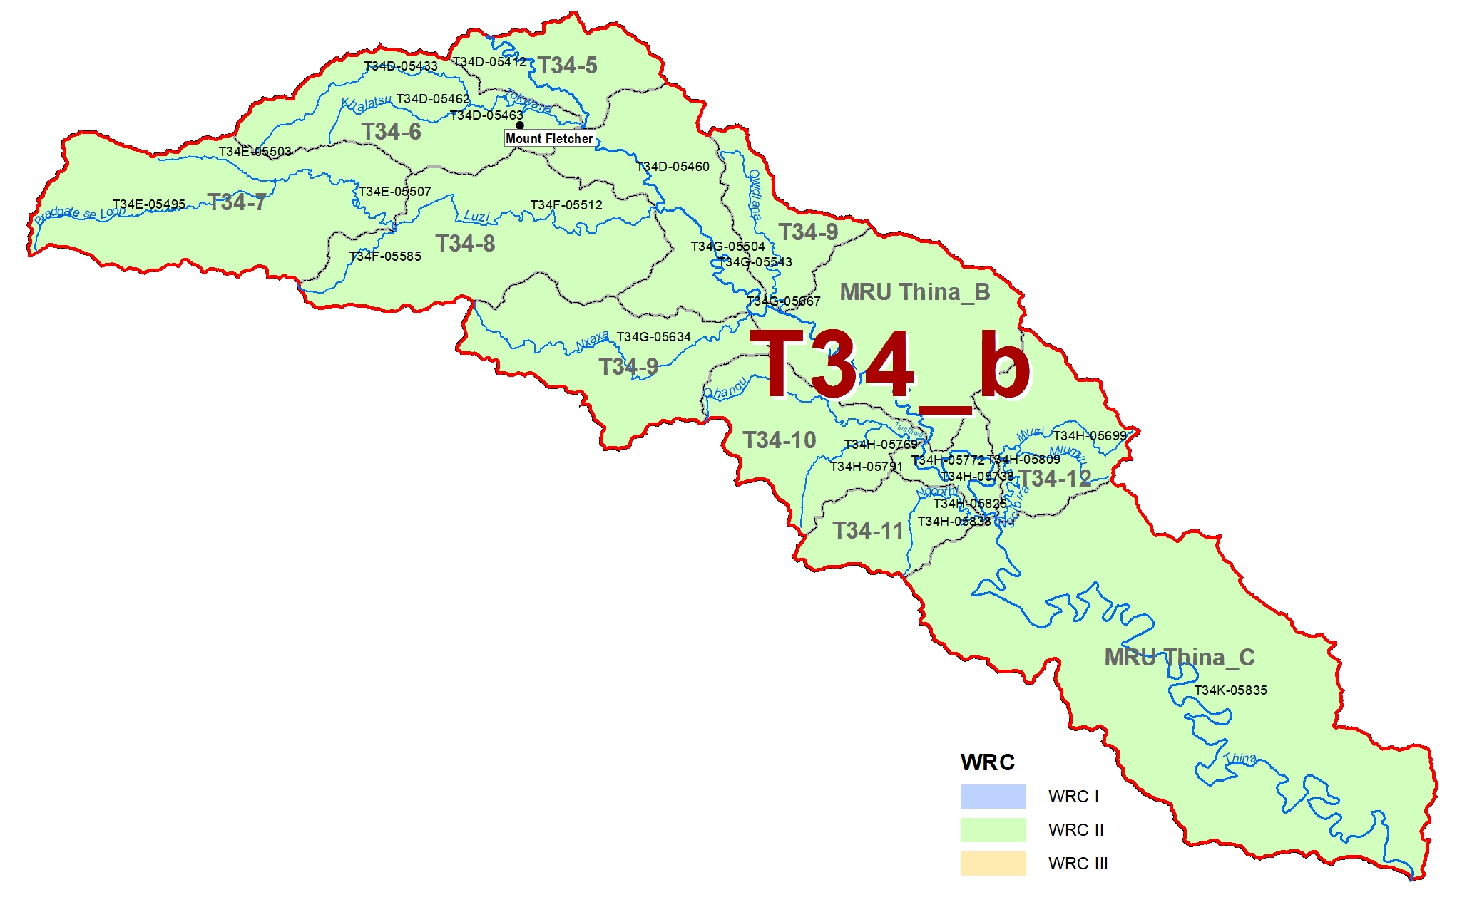
DRAFT WRC: IUA T34_b
T34-5, Thina River: C → B/C
Supply the EWR from the dam. Improve the WWTW discharge quality.

Slide 15
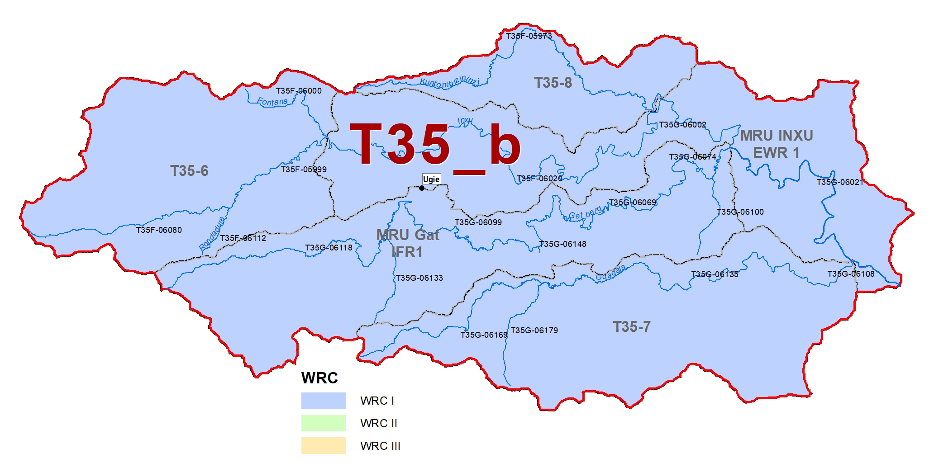
DRAFT WRC: IUA T35_b
MRU Gat IFR1, Gatberg River: B/C → B,
Flow modification can only improve if dams are managed to ensure EWR.
WRC I
No direct impact on users/economy and ecology

Slide 16
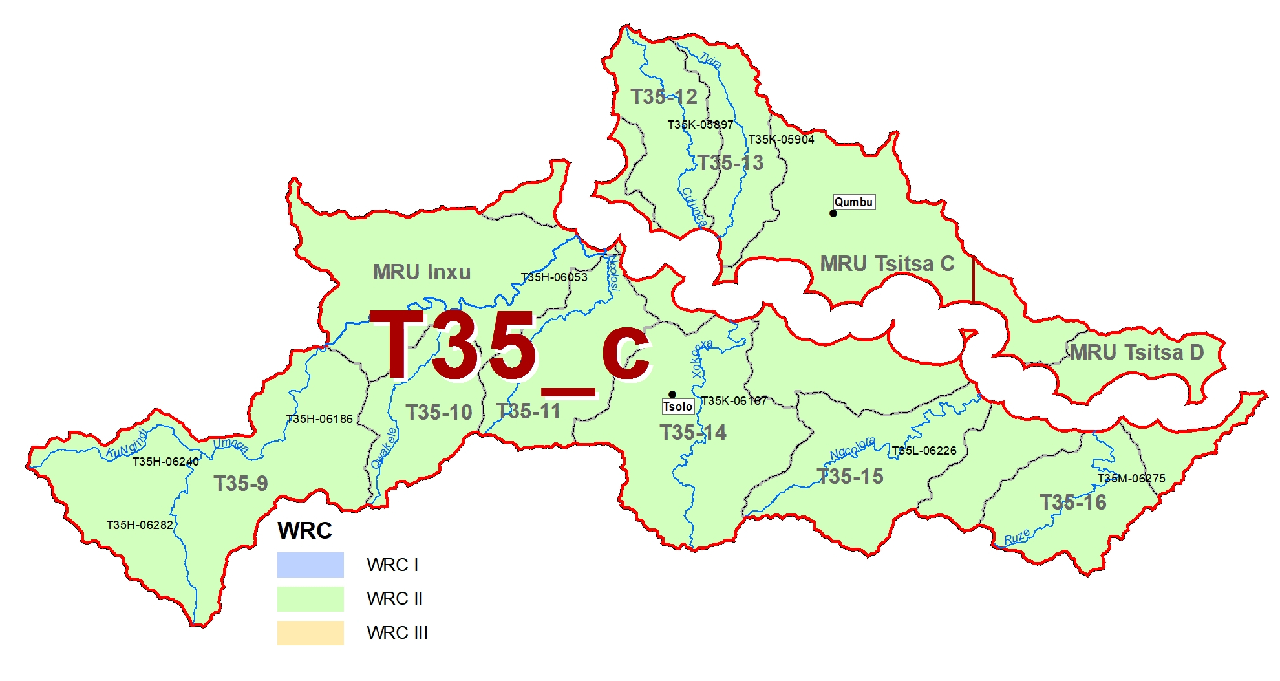
DRAFT WRC: IUA T35_c
T35-12, Culunca River: C → B/C
Improve the riparian zone condition (erosion control and limit cultivation in zone) to improve water quality.
T35-10, Qwakele River: C → B/C.
Improve the riparian zone condition (erosion control and limit cultivation in zone) to improve water quality.
T35-11, Ncolosi River: C/D → C
Improve the riparian zone condition (erosion control and limit cultivation in zone) to improve water quality.

Slide 17
QUESTIONS FOR CLARIFICATION

